Slide 1




Enabling hybrid and additive approaches to medical and industrial devices Mark D. Poliks SUNY Distinguished Professor Empire Innovation Professor Director, Center for Advanced Microelectronics Manufacturing A New York State Center of Advanced Technology New York Node, NextFlex Manufacturing USA Binghamton University, State University of New York mpoliks@binghamton.edu 607-727-7104 (mobile)
1

Slide 2








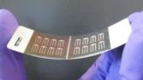





S³IP Organization Chart
Dr. Bahgat Sammakia, Director and VP for Research
Mr. Benson Chan, Associate Director
Binghamton University Faculty & Students
COE
Prof. SB Park Director
Prof. Bahgat Sammakia; Prof. Kanad Ghose; Prof. Ganesh Subbarayan (Purdue), Co-directors
Prof. Mark Poliks Director
Prof. Kanad Ghose Director
Prof. Tara Dhakal
Director
Prof. Stan Whittingham Director
IEEC
CHIRP
CAMM
ES2
CASP
Advanced Solar Energy
NECCES
Advanced Batteries
Electronics Packaging
Heterogeneous Integration
Flexible Electronics
Energy-Smart Electronic Systems
NYS CAT
SRC
DoD Manufacturing USA
NSF I/UCRC
NSF Early Career
DoE EFRC
NSF Engine, etc.
NYS CAT
Analytical and Diagnostics Laboratory
Dr. Jenny Sammakia, Director

Slide 3
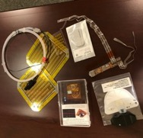
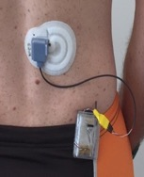

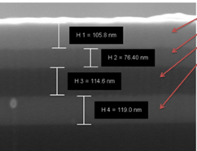
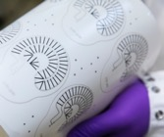
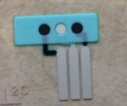
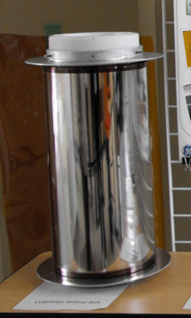
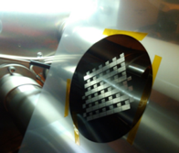
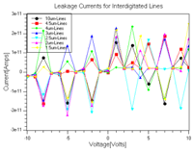
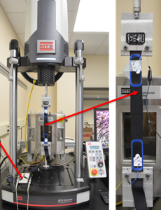
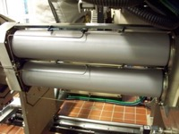
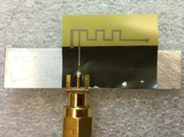
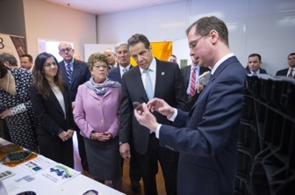
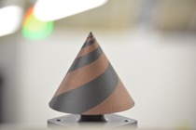
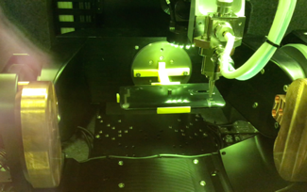
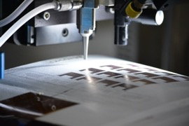
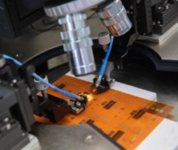

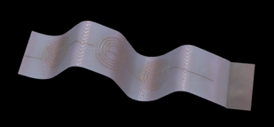
Center for Advanced Microelectronics Manufacturing
CAMM was founded in 2005 with funds from NYS and ARL
A New York State Center of Advanced Technology (CAT)
New York Node NextFlex Manufacturing USA
Specialized facilities for large panel, roll-to-roll, printed and component assembly, fabrication and test
~10-15 unique projects at a given time
Support company (and academic) related R&D programs
Technical staff of five, plus graduate students working on funded projects, also, in part, operate as a user facility
Host three companies within CAMM facilities
Funded by company, federal, and NYS (CAT), responsible for economic development in NYS
Approximately 10K sq ft of class 1000 capable cleanroom space located at the Huron Campus, Endicott NY (former IBM site). More than 30K sq ft in three locations
In addition: S3IP NYS Center of Excellence affiliated supporting facilities and centers (IEEC, SRC-CHIRP, ES2, ADL, NLab, etc.)

Slide 4
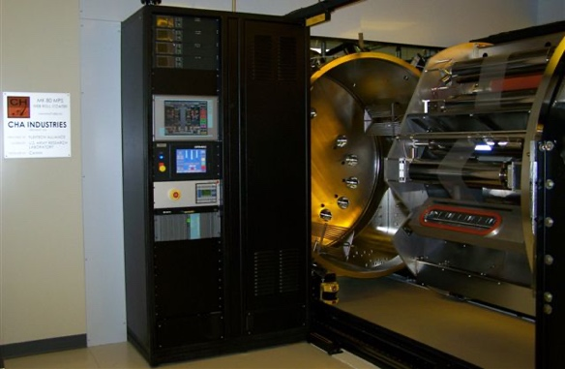
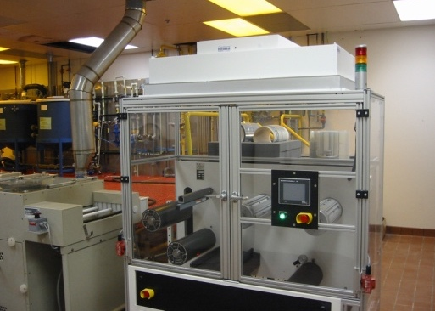
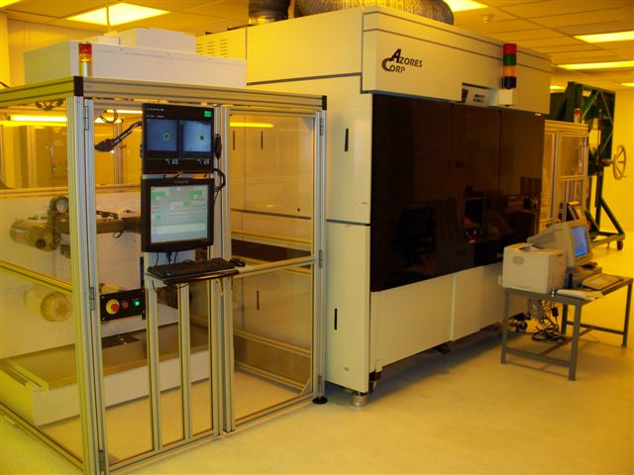
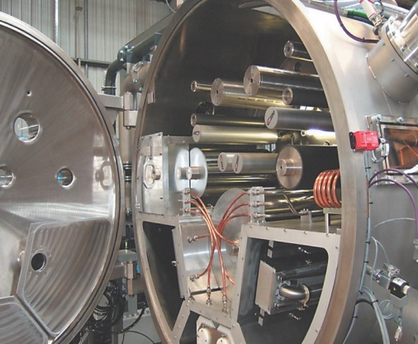
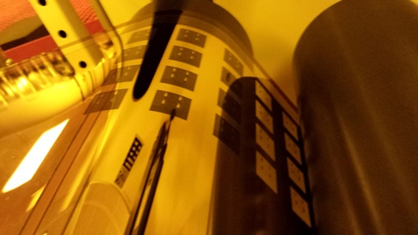
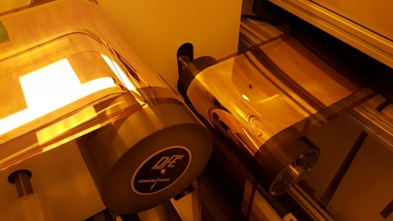
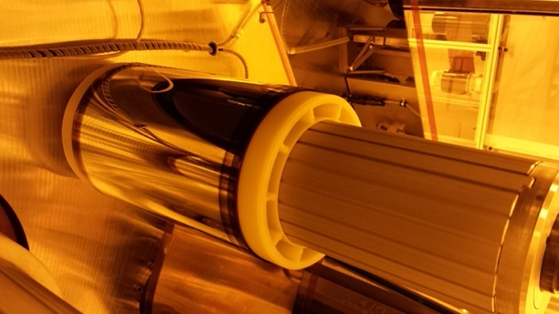
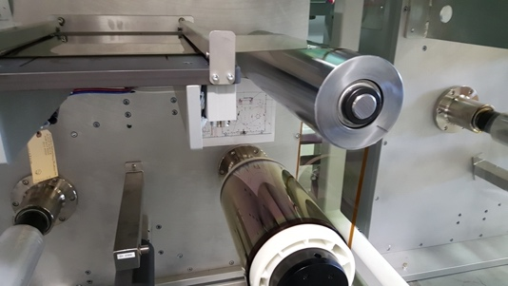
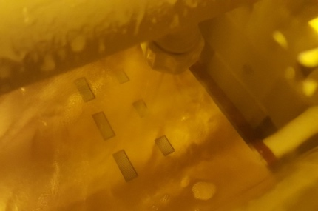
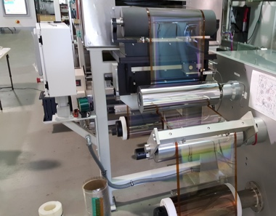
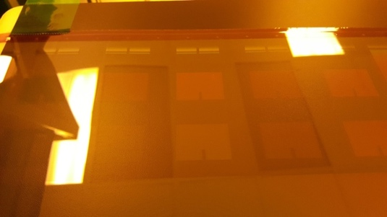
Other CAMM and S3IP Facilities and Equipment
Roll-to-Roll Manufacturing Facilities:
Lithography
Vacuum Sputter Deposition (KDF, GVE, and CHA)
Handling, Inspection, Lamination, and Wet Processing
Characterization:
Keyence VK-X1050 laser scanning confocal microscope
VHX-6000 digital microscope
RF vector network analyzers up to 40 GHz
LCR meters and data acquisitions units
Netzsch DEA 288 Dielectric Analyzer
High precision electrical resistance meters, source meters, and power supplies
Other S3IP Facilities & Equipment
Analytical and Diagnostics Lab (ADL)
SEMS/ TEM / FIB
IR microscope
X-ray, CT scan, and CSAM
Materials and element analysis equipment (XPS, EDX, FRIR,…)
Thermal suite includes DSC, TGA and TGA/MS,…
IEEC , Failure Analysis and Reliability Lab
The Nanofabrication Lab
Other equipment:
Novacentrix PulseForge Invent photonic curing
Atmospheric plasma jet-flow system for surface modification
Contact angle measurement (goniometer)
Dremel Digilab LC40 laser cutter
FinTech Pico pick and place
Rheomter and viscometer

Slide 5
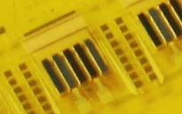
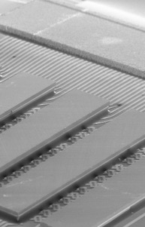
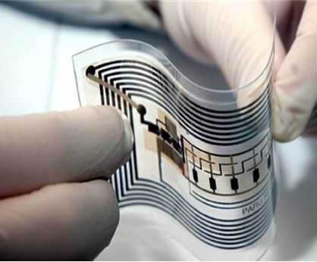

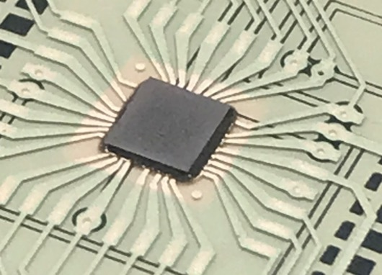
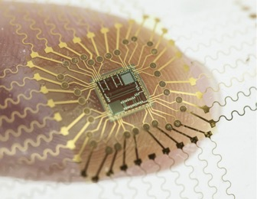
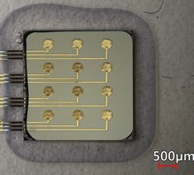
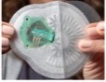
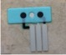
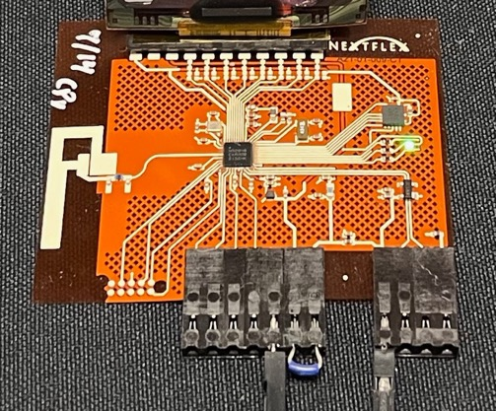
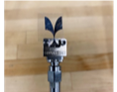
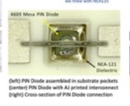
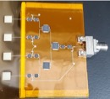
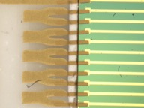
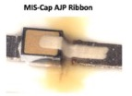
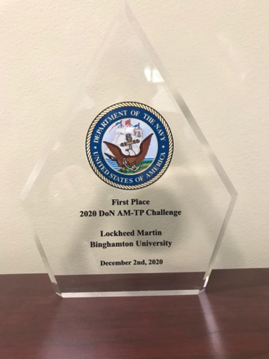
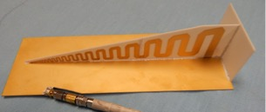
Flexible, Hybrid & Additive
Understand the challenges to interface thin, hard and soft electronic components – neutral axis engineering
Heterogeneous device Integration
Thinned semiconductor device handling, placement, assembly, anisotropic conductive adhesives
Printing, patterning, conductive inks & sintering
Sustainable materials and fabrication processes
Interconnecting in the z-direction: printed vias
Additive manufacturing of resistors, capacitors, inductors & interconnects
Stretchable & highly stretchable conductive inks
Printed RF components design & fabrication, interconnects and high-temperature applications
Wearable medical devices
Multilayer printed & laminated structures
Sweat and hydration patch – microfluidic channels & printed electrochemical sensors
Vital signs patch for ambulatory aeromedical care
Planar SiC high-power module packaging with printed interconnections
Electromechanical, RF, temperature/humidity, power cycling testing and reliability studies

Slide 6
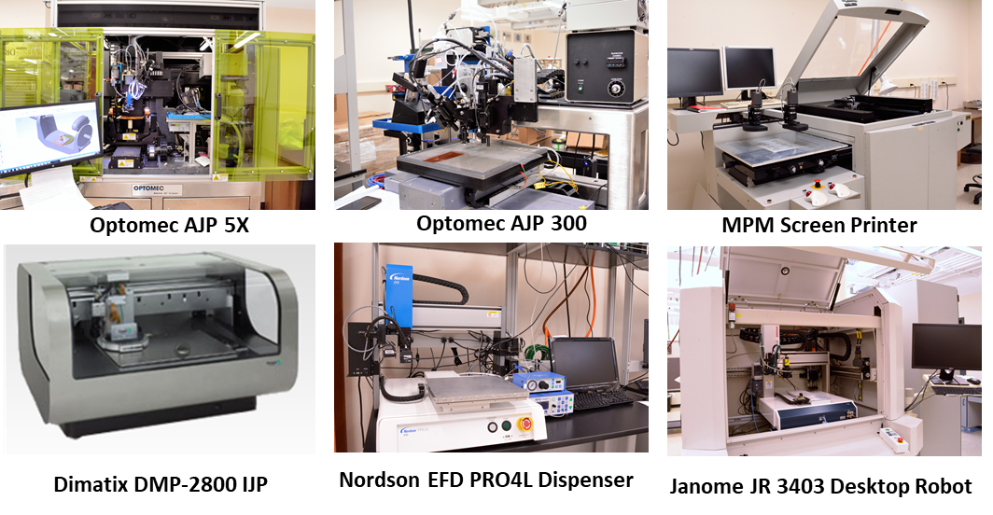
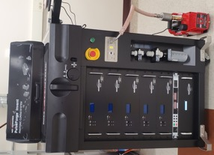
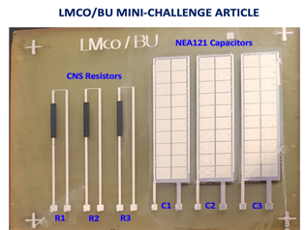



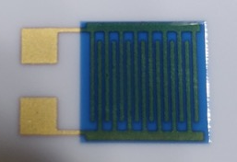
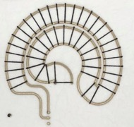










Example of Facilities: Additive Manufacturing -- Printing and Processing
Substantial printing equipment including AJP 5X and 3X, stencil/screen printers, dispensers, and inkjet printers
Laser sintering module (up to 40W) with reducing gas environment and UV curing module as well.
Demonstrated printing different inks on many substrates in planar and 3D complex irregular substrates
PulseForge Invent photonic sintering, convection ovens, high temp furnaces, UV expose, laser cutting etc
Confocal Printing
Silver on Paper
Silver Via on PI
CNS on PET
Ag & dielectric on LCP
Dielectric and Au on Ceramic
Large Area Printed Sensors
Au on Ceramic
Au on 40µm Ceramic
Photoresist on FR4
Platinum on Ceramic
Silver on PI
Multilayers Leadset

Slide 7










XTPL Ultra-Precise Printing
XTPL _ Delta Printing System
High resolution printing method.
Combines high-precision pressure control and axes.
Flexible glass capillary tips.
Ink: Heraeus RP Au 041008/HT (high temperature Au ink)
Characterization:
Design-01
0.5 mm
0.5 mm
3 mm
X-axis camera
Average conductivity 2.7X10^7 S/m
67.5% of bulk gold
High-precision pressure inlet
Y-axis camera
Printed Traces Conductivity
Light
Light
Flexible glass capillary tip
XTPL Printhead Schematic
Firing:
Drying the printed samples in the box oven at 90°C for 15 mins.
Firing the samples at 850°C for 10 mins in high temperature furnace.
50X Magnification
Trace profile
XTPL Printer at CAMM
Design-02
SEM of gold particle free ink after firing (15K Mag.)
15K Mag.
Notes:
- High-resolution printing method ∼ 1µm to nano printing.
- Ink: high-mass loading, small particle size and high viscosity.
- Developing high-temperature and embedded electronics, especially in aerospace applications.
- Using XTPL technology could drive advancements in microelectronics industry.

Slide 8


Progress In Advanced Printing Technologies (Micro Dispensing)
XTPL® Delta Printing System
Micro AM 3D printer that uses Ultra Precision Deposition (UPD) technology
Łysień, Mateusz, et al. "High-resolution deposition of conductive and insulating materials at micrometer scale on complex substrates." Scientific Reports 12.1 (2022): 9327.

Slide 9




Ink Continuity and Printing Interconnects on Irregular Surfaces (2/2)
Printing on Si Dies
The interconnects were printed from the Si die into the PET substrate.
200 μm diameter pads (25 nos.) and 300 μm ones (12 nos.) were printed to investigate the footprint area that can be obtained on 3x3 mm Si die
Printing with 3 layers
Cured at 140°C for 1 hr.
35 µm wide circuit lines are 5-7 ohms
NEA123
NEA123
200μm pads
300μm pads
3X3mm Si die
3X3mm Si die
Printed Ag ink
Printed Ag ink
25 pads (200μm)
12 pads (300μm)
A daisy chain was printed to link several test pads in a sequential chain.
The average resistance at different sides of the daisy chain is 32.4 Ω, which demonstrates the stability of printed silver particle-free ink over irregular objects.
Printed daisy chain between dog bone pads on Si die and PET substrate
0.380 µm lines thickness

Slide 10












Vital Signs Patch
Interstitial Fluid Patch
Sweat Hydration Patch
-Continuous wireless vital signs sensing for up to 1 week (Clinical grade)
3-Lead ECG, Respiration, Reflective PPG, Core Body / Skin Temperature, Accelerometer
- End-to-end prototype manufacturing & supply chain development
Disposable devices
- Algorithms
Android UI, Decision Making, CNIBP
-On-demand wireless minimally invasive measurement of metabolites, proteins and hormone concentrations
Lactate, cytokines, catecholamines. Patch actuation
-End-to-end prototype manufacturing & supply chain development
Reusable electronics unit & disposable sensors
- Algorithms
Android UI
- Continuous wireless hydration sensing during moderate/intense exercise for up to 24 hours
Electrolytes (Na, K), Sweat rate
-End-to-end prototype manufacturing & supply chain development
Reusable electronics unit & disposable sensors
- Algorithms
Android UI

Slide 11





















Human Subject Testing
Partnerships
Ambulatory Patient Monitoring & En-Route Care
From the Lab to Manufacturing Supply Chain to End-users
Image courtesy of AFRL
Image courtesy of AFRL
Hydration Status & Heat Stress Assessment
Patient Monitoring at Home:
Prediction and Prognosis of Infectious Diseases
Synergistic Activities
Continuum of care
DARPA MBA (GE): Performance & Aptitude Assessment & Human Subject Studies at West Point

Slide 12













RF Design, Modeling/Simulation, and Test
Design Tools
ANSYS High-frequency structure simulator (HFSS)
Advanced Design System (ADS)
RF vector network analyzers up to 40 GHz with various RF probes and horn antennas, test chamber
Substantial experience in understanding the effect of printing method, inks, substrates, postprocessing, and mechanical and environmental stress on RF performance
Interrogation of printed antenna array embedded into fiberglass composite during mechanical testing
S-parameters measurements of printed gold transmission lines onto 3D printed ceramic up to 750 °C
A broadband antenna for 2.4GHz was fabricated using suitable materials found to sustain 750°C.
Various RF components AJP printed on PI
IJP patch antenna during bending
Stretchable Microstrip line w/ vias, printed with Liquid Metal
Inverted F-Antenna
Microstrip Lines
12 GHz phase array

Slide 13

You are invited to join us!
Keynote lecture
Poster session
Reception
& more

Slide 14
Join us for the 36th Annual Electronics Packaging Symposium
at the GE Research (Aerospace) Campus!

Slide 15


























CAMM Research Partners
Organic Robotics Corporation

